Slide 1


Global Economic and Demographic Trends Analysis
Surya V
03-03-2025
Data analytics & Data science
Oct 2024

Slide 2
PROJECT OVERVIEW:
Global economic and demographic trends play a crucial role in understanding the development patterns of countries and regions.
This project aims to analyze key economic, population, and health indicators to derive insights into how different nations evolve over time.
OBJECTIVES:
Analyse Population Growth Trends.
Evaluate GDP and Economic Performance.
Relationship Between Health and Economy.
Assess Birthrate and Death Rate Trends.
Perform Statistical and Predictive Analysis.
Creating Dashboard.
Insights and recommendation.

Slide 3
DATASET OVEVIEW:
SQL Database: Countries World
Fields: Country, Population, GDP, Literacy, Infant Mortality, etc.
Excel Files:
Population Per Country: Population data (1960-2016).
Meta Data: Country classifications (Region, Income Group).
GDP by Country: GDP trends (1960-2016).

Slide 4
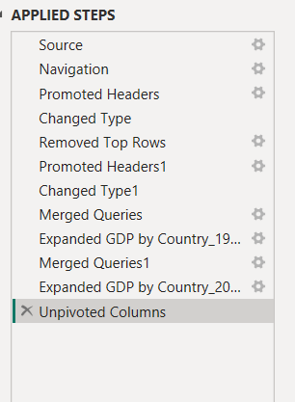
DATA CLEANING:
Handling Missing Values
Remove duplicate.
Unpivoted & Appended GDP Tables.
Inconsistent Values.
Standardized data types.

Slide 5
Descriptive Statistical Analysis & Dax Function:
Mean, median, and mode for key indicators.
Distribution analysis for GDP, life expectancy, and population growth.
The average literacy rate across regions and countries.
The countries with the highest and lowest GDP.
Identification of trends and outliers over the decades.

Slide 6
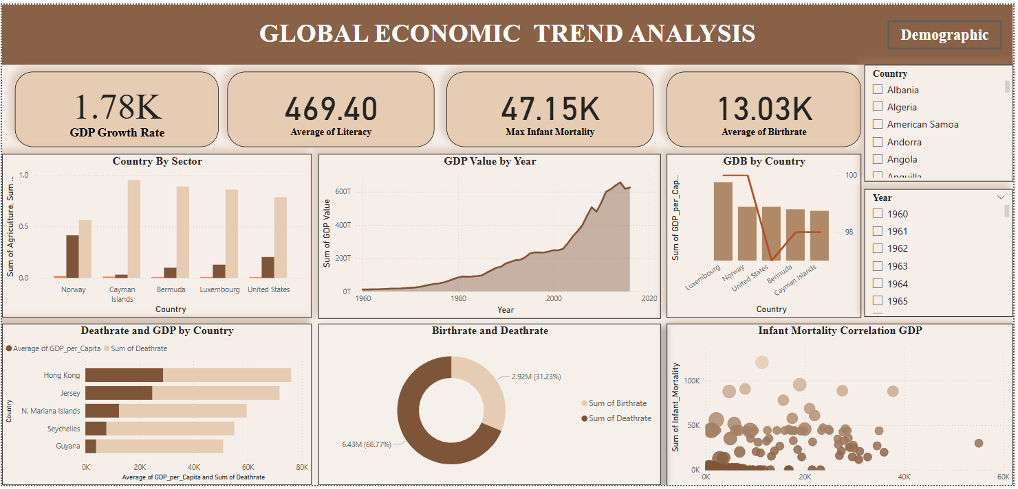
DASHBOARD

Slide 7
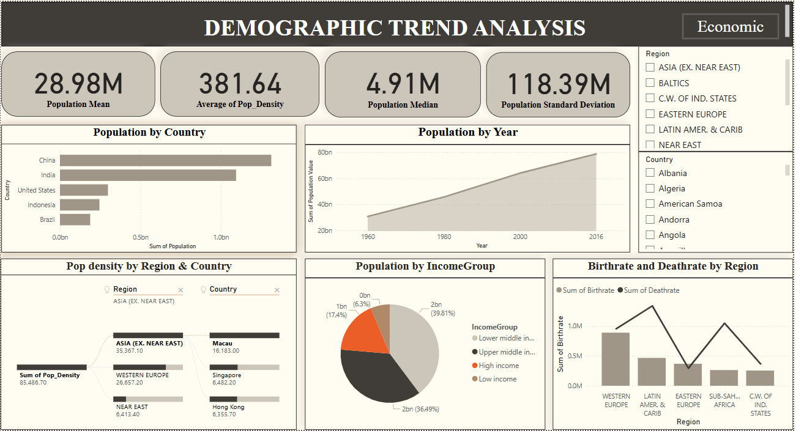
DASHBOARD

Slide 8
INSIGHTS:
Luxembourg has the highest GDP.
Western Sahara has the lowest GDP.
Asia has the highest population density.
GDP Growth Fluctuations – GDP growth has been unstable, especially after 2000, with slower expansion in some years.
Population Growth – Global population is rising due to better living conditions and healthcare.
Birthrate & Economy – Wealthier countries have lower birthrates, while poorer nations have higher birthrates due to limited healthcare.
Infant Mortality & Healthcare – Richer countries have lower infant mortality because of better healthcare systems.

Slide 9
RECOMMENDATION:
Invest in Education & Literacy → Higher literacy leads to better job opportunities and GDP growth.
Improve Healthcare Access → Reduces infant mortality and increases life expectancy.
Support Economic Diversification → Countries dependent on a single industry (e.g., oil, agriculture) should expand into tech, finance, and manufacturing.
Urban Development & Infrastructure → High-density regions need smart city planning to sustain population growth.
Foster Foreign Investment → Encouraging investments in developing economies can boost GDP and reduce poverty.
Increase Agricultural Productivity – Modernize farming and supply chains

Slide 10
Thank You

